Slide 1

Social Media
Instagram
Facebook
Twitter
Snapchat
Business attention and advertisement
Twitch
YouTube

Slide 2

What is Social Media?
+It can be a place for people to post their pictures and life updates, personal opinions, interests, problems.
+A place to keep up with the world and share information.
+There are 4.5 billion people using social media.
+It broads around all ages and groups of people
So why is it being used?
Entertainment
Communication
Learning
Stress relief
Advertisement

Slide 3
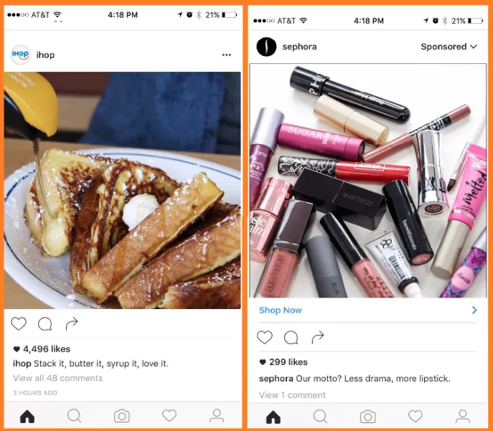
So why not other advertisement methods?
Word of Mouth – Would be cheaper and easier. However, it's inefficient.
Billboards – Would be more expensive and is stationary so the position of it is significant.
Tv ad - It would be seen by many people. However, it's expensive.
Social Media – It is cheap or free. And it can target anyone desired.

Slide 4
Benefits of Social Media as marketing
Drawbacks of Social Media as marketing
Cost effective and Time effective.
Customer Satisfaction.
Easy to target specific groups of people.
Easy to see people's opinions.
Exposure to competitors. Other businesses can see and copy your ideas.
If something negative is posted or presented, it can ruin their reputation.

